Slide 1
CBM Spring 2014
Dr. Hao Peng
Pav. E.3
h.peng@tue.nl

Slide 2
Lectures’ subjects
22 May: 8:45-10:30 (LaPlace Building 1.19)
  Delay Time Model
5 June: 8:45-10:30 (LaPlace Building 1.19)
  Degradation Model
  Source: lecture note

Slide 3
Multi-state systems
For CBM, there are multiple intermediate states.
Three states: normal, defective, failure
Multiple discrete states: newest (initial), deterioration states, failure
Continuous state: newest (initial), deterioration state, failure
Notes:
1, dimension, strength, smoothness of rubbing surfaces
2, oxide thickness
3, fill volumn
4. Blood pressure
5, percentage of ingredients

Slide 4
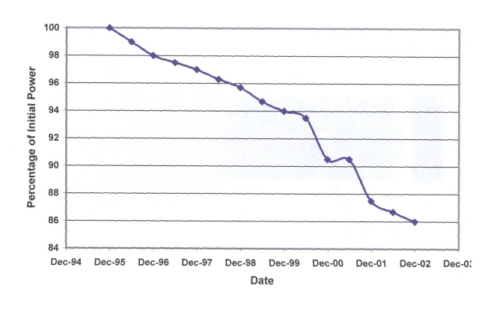
Solar Panel
http://www.solarstorms.org/Svulnerability.html

Slide 5
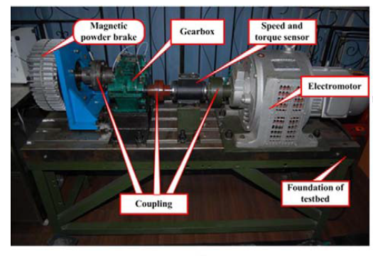
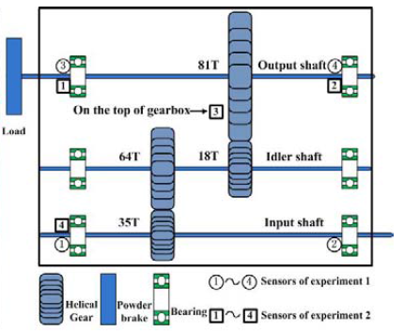

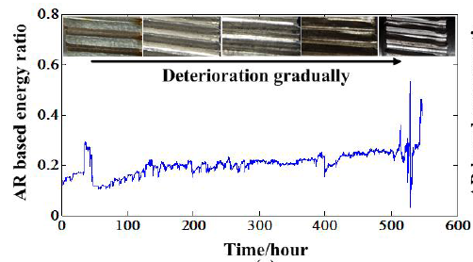
Gear Box

Slide 6
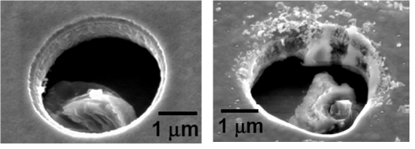
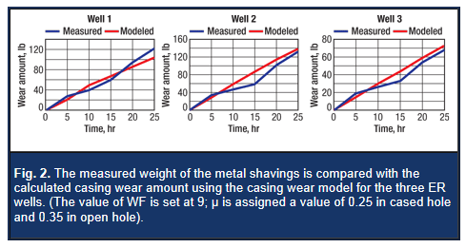
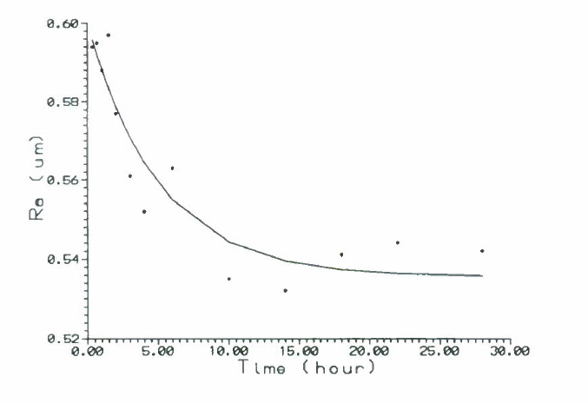
Wear-out of moving/rotating parts

Slide 7
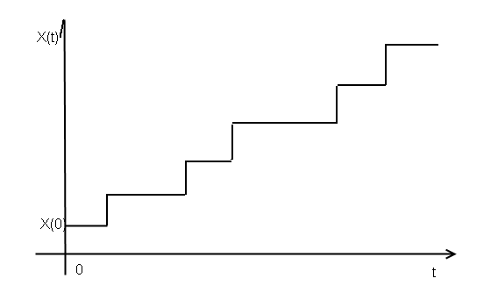
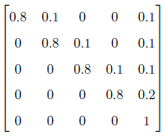
Multiple discrete states
Transition matrix (relatively hard to estimate ) pij
Failure limit
j
i
Markov Decision Process
Assume we can observe the system state at every time epoch. At each system state, we must take an action (e.g., continue operation or replacement) from several alternatives, and a certain cost will be incurred.
To minimize the expected cost, we optimize the actions that we plan to take for each system state.

Slide 8
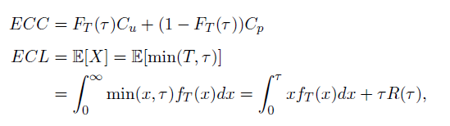
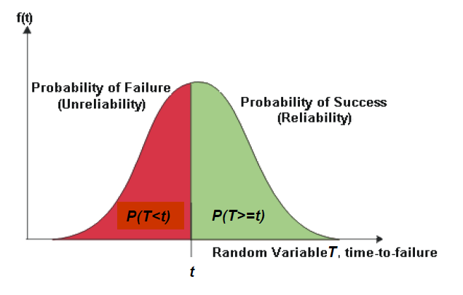
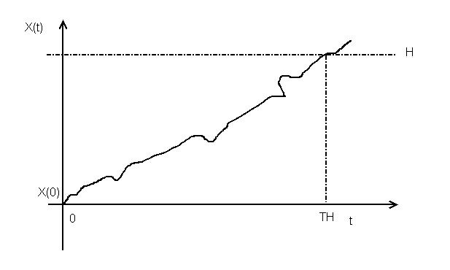
Continuous system state
Online, real time, sensor driven
Remaining useful lifetime prediction
  (statistical approaches)
Age-based policy can be applied for decision makers who want to evaluate the expected cost

Slide 9
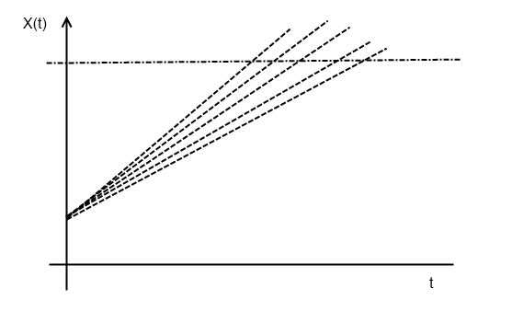
Continuous system state
Offline, only have historical data of other components that belong to the same type (from field or from lab )
No sensor installed
How to schedule the inspection and maintenance policies?
How can we schedule inspections to replace the component before the degradation hits the failure limit?

Slide 10
Periodic inspection policy (offline)
Inspect the system every tau time units till the degradation level passes a control limit C
We could make it dynamic using Remaining useful lifetime distribution. However, for multi-component systems, this policy is a good building block.
C
tau

Slide 11
Periodic inspection policy (offline)
If the degradation process X(t) follows a certain stochastic process,
  the first passage time of X(t) over C is Tc
  The first passage time of X(t) over H is Th
what are the renewal events?
  Failure renewal
  Inspection renewal when the degradation level is larger than C
What are the probabilities of these renewal events at the end of a renewal cycle?

Slide 12
Periodic inspection policy (offline)
How to calculate first passage time? (for random coefficient models)

Slide 13
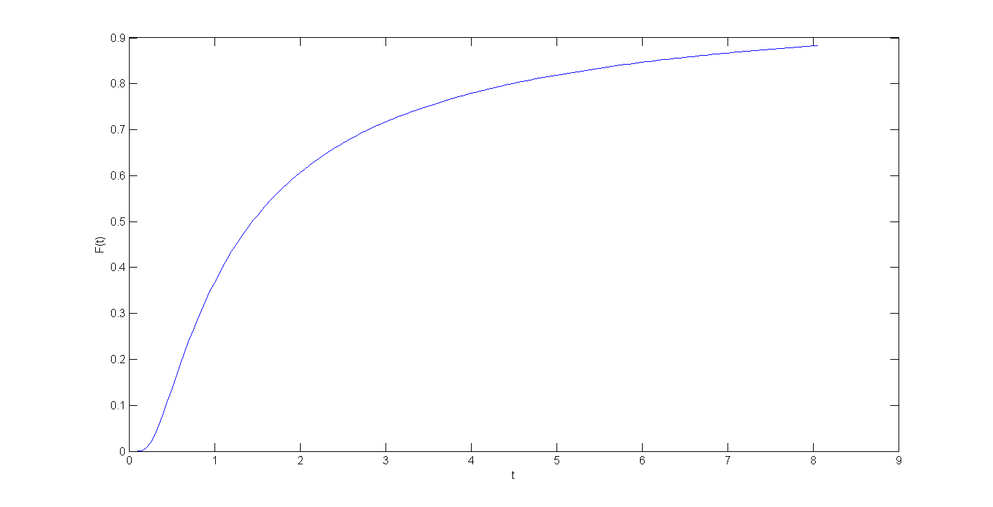
Periodic inspection policy (offline)
Cdf of first passage time

Slide 14
Periodic inspection policy (offline)
Conditional first passage time
The first passage time over H given that the first passage time over C (<H) takes a certain value u
  Note that if we include not only the unit-to-unit variance, but also the temporal (time-dependent) variance of the degradation process, this conditional first passage time should also be a random variable.

Slide 15
Periodic inspection policy (offline)
Numerical example
Phi=1
Theta~Exponential(lambda=1)
H=5
Ccm=1000
Cpm=150
Ci=15
Numerical calculation is not required for the exam.

Slide 16
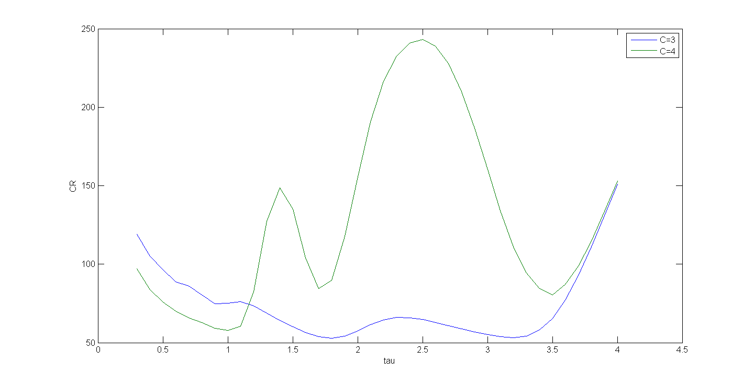
Periodic inspection policy (offline)

Slide 17
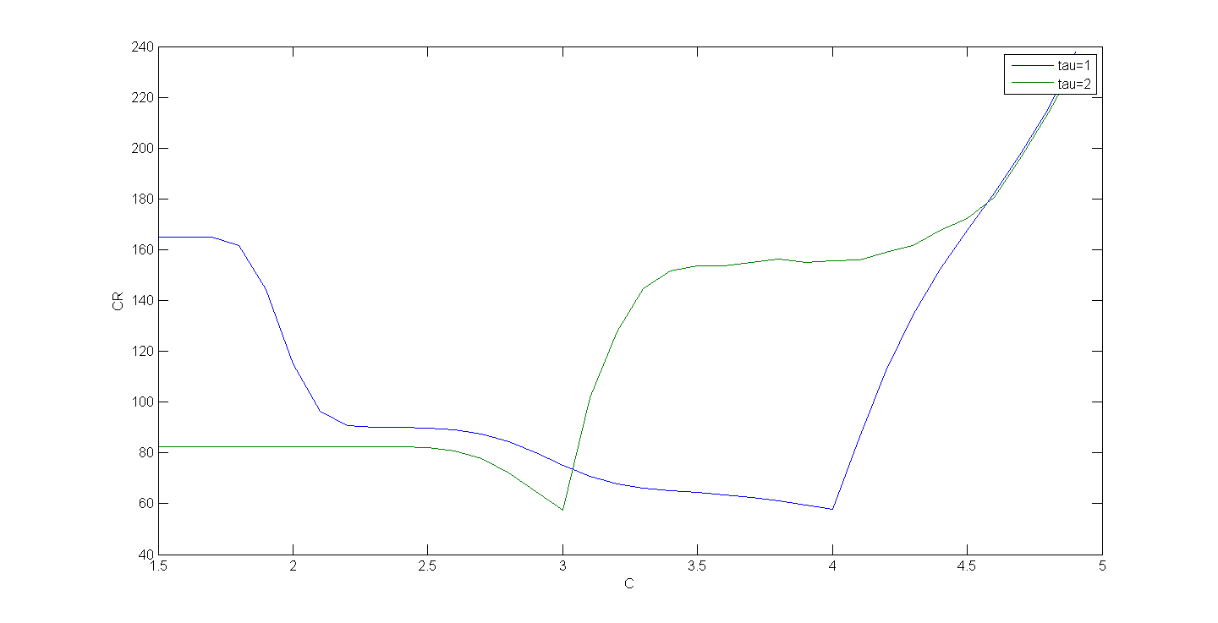
Periodic inspection policy (offline)

Slide 18
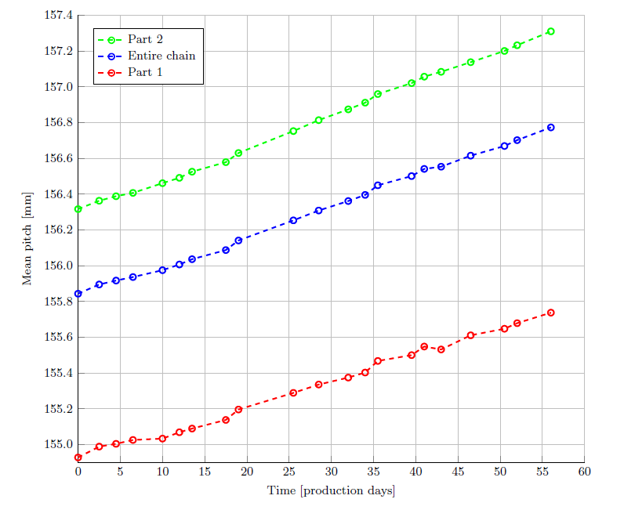
A master project at Marel Stork
Monitoring device design
Data collection and estimation

Slide 19
Estimation
Expert information (failure mechanism)
  Surveys, questionnaires
Lab testing (degradation data, accelerated testing)
Field data (degradation data)
  Linear regression

